Slide 1


Slide 2
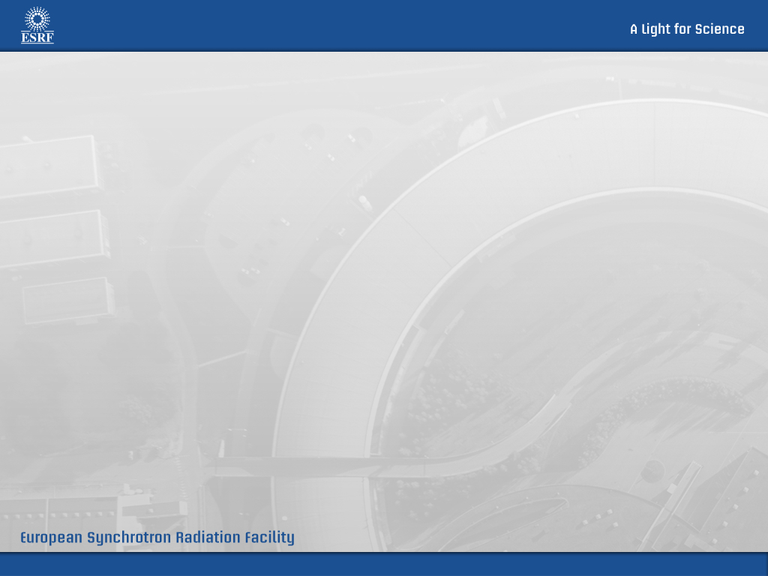
Index
Current state
Terms
Use cases (Architecture of ISPyB)
Demo
Road map

Slide 3

Terms
Macromolecule
Biological construct in solution for investigation
Buffer
The solution in which a macromolecule is suspended
Additive
Any component of the buffer which will be varied in an experiment (salts, ligands, detergents lipids, deuteration)
Specimen
Any solution with or without macromolecule. We name specimen the solution which a well is filled in. It contains: volume in well, macromolecule, buffer, concentration and position in a plate.
Measurement
Measurement details for the specimen. It means HOW we are going to make the data acquisition. We can measure a specimen several times. It contains: exposure temperature, transmission, viscosity, extra flow time, flow)

Slide 4
Terms
Frame
One individual exposure of the detector (refers to both both the 2D detector image .edf and the reduced 1D curve .dat)
Frame Set
All frames for an individual acquisition (for the same specimen). Each frame set may contain > 1 frames. It contains all the common parameters for all the frames. Each frame set is associated to one detector
Run
Set of frame set for an individual acquisition. There will be the same frame sets as detectors. It also contains all the common parameters for all the frame sets as transmission, exposure temperature, time start, time end, etc…
Data collection
Combination of runs. (buffer before – sample – buffer after)

Slide 5
Interaction with ISPyB
From the web
From web services

